Slide 1
Engagement Working Group Agency (Treasury) and Bureau (IRS) Best Practices
July 25, 2019

Slide 2
The Engagement loop
Planning
Tools
Communication

Slide 3
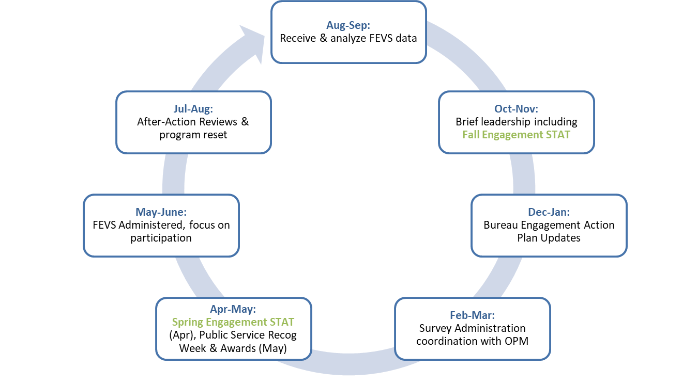
Planning: Treasury Annual Engagement Action Cycle

Slide 4
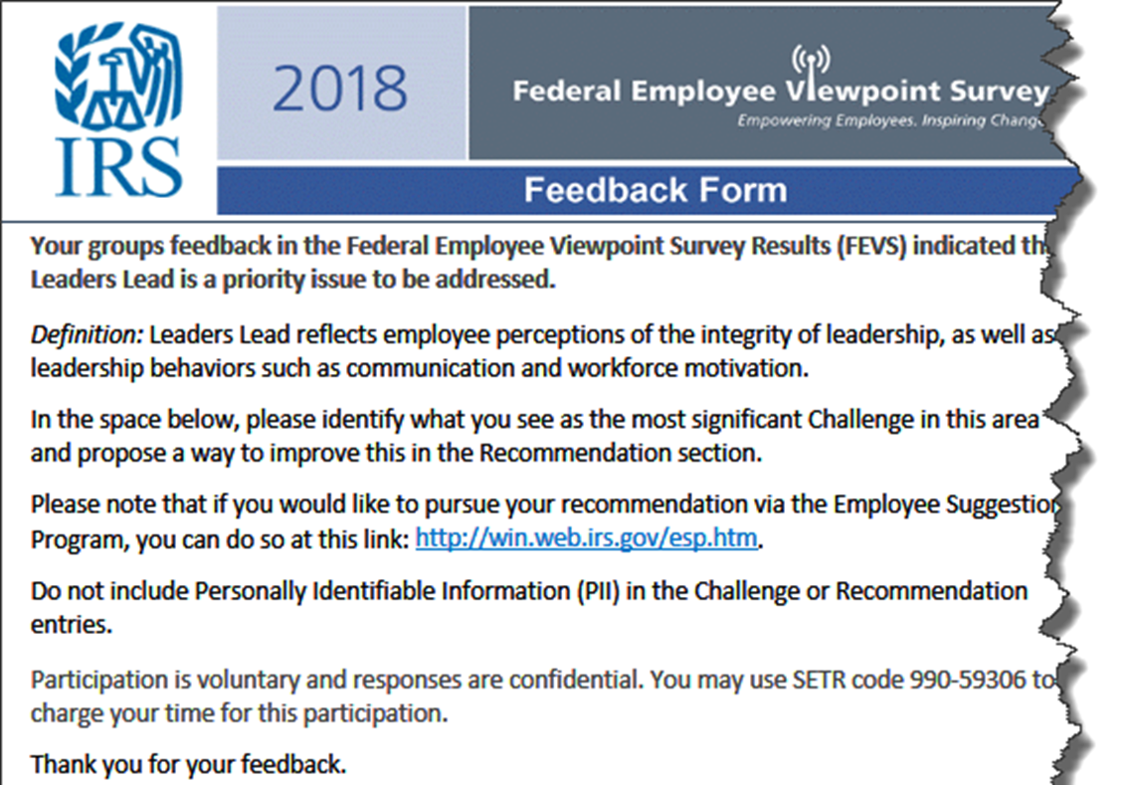
Planning: Feedback

Slide 5
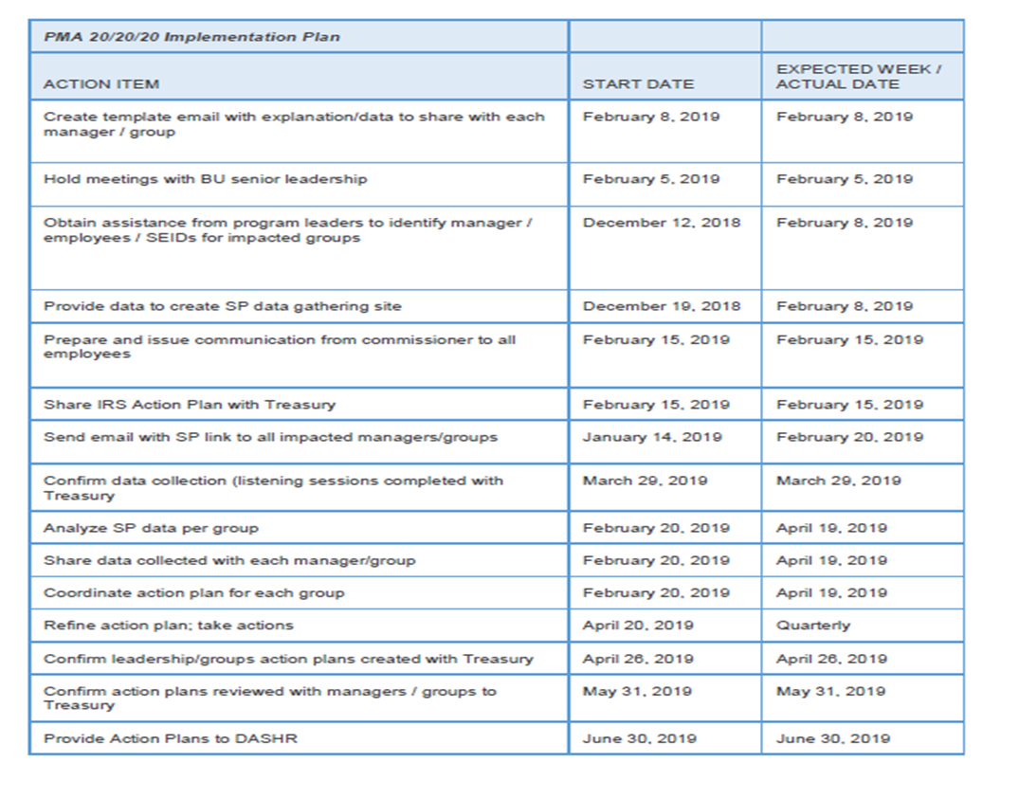
Planning: Engagement Strategy

Slide 6
Planning: Individual Workgroups
Organization Name | Organization Code
XXXXXXXXXXXXXXXXX | TRXXXXXXXXX

Slide 7
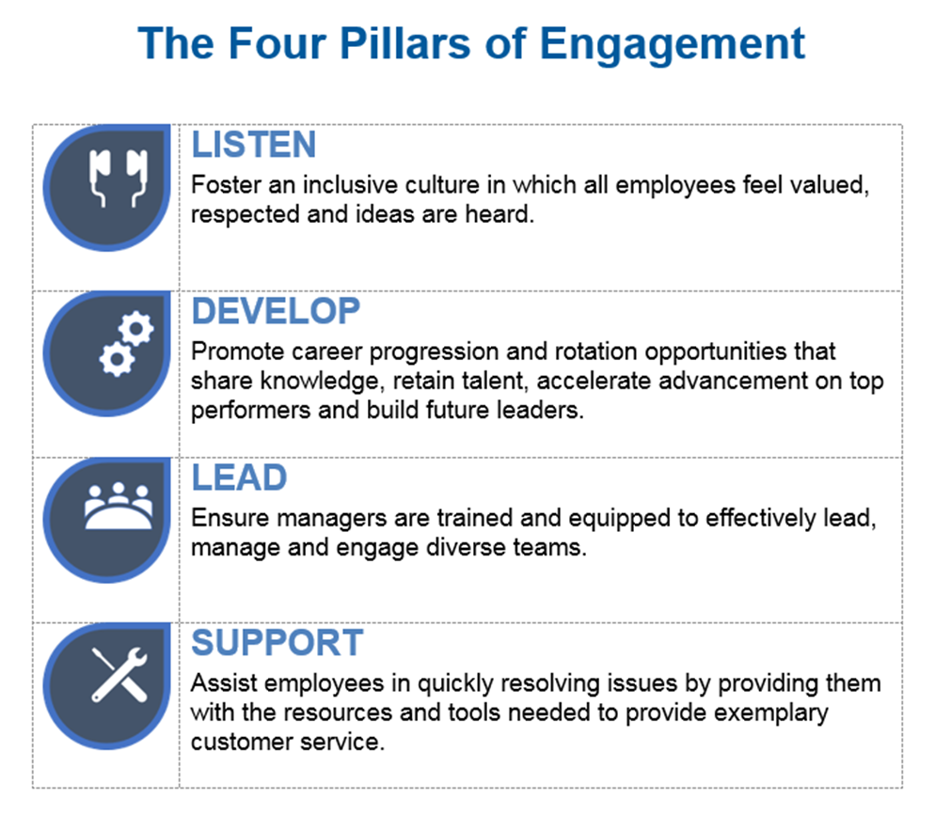
Planning: Theme for buy-in

Slide 8
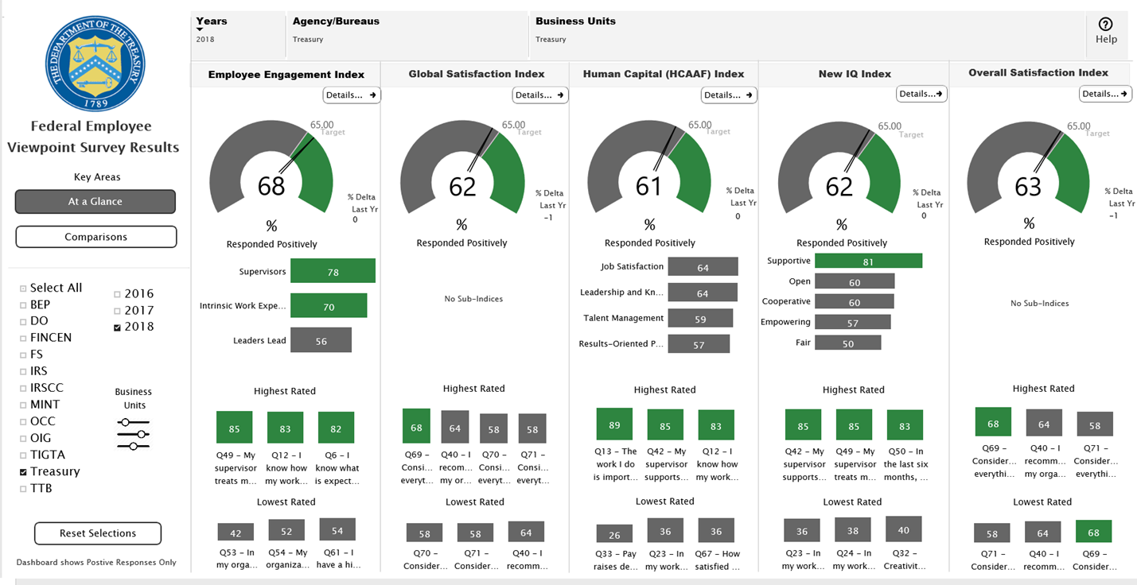
Tools: FEVS Dashboard

Slide 9
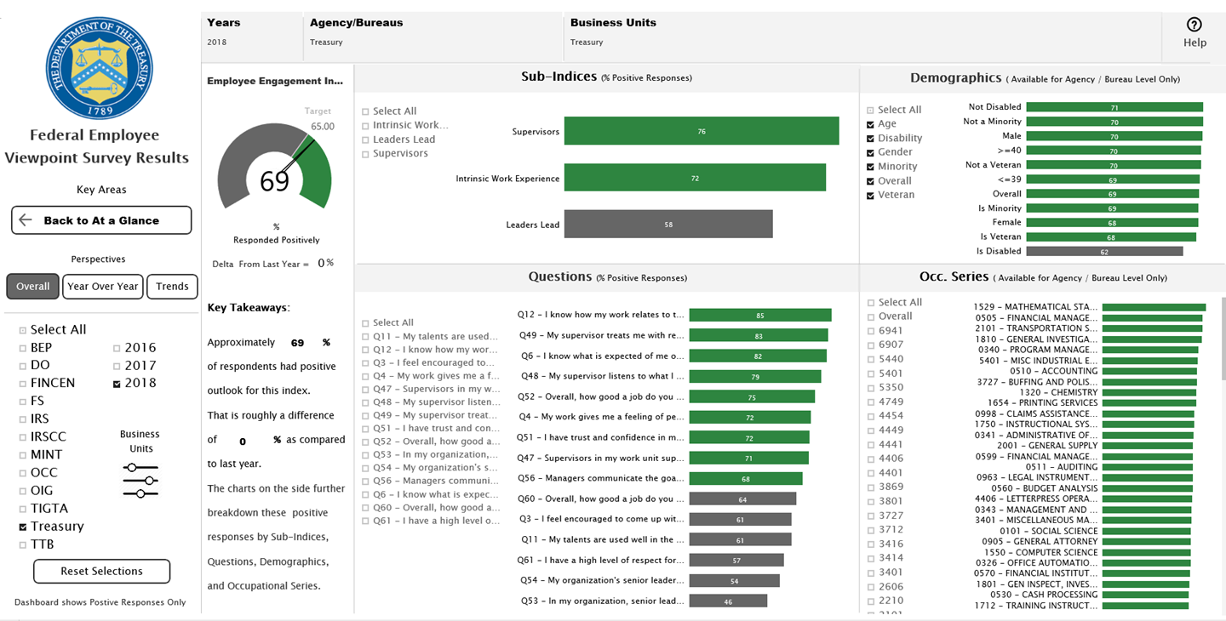
Tools: FEVS Dashboard(cont.)

Slide 10
Tools: Using statistics to identify possible actions

Slide 11
Communicating: Spreading the word
Treasury hosts regular meetings with all Bureau Engagement leads to share information. A recent meeting highlighted:
The statistical relationship between Employee Engagement, Empowerment and Risk Management
A talk by the IRS Chief Risk Officer on how to enable better Risk management practices through Employee Engagement
Treasury also has Engagement Roadshows at the Bureaus to meet and share information with Bureau HR professionals, senior leaders, management, and supervisors

Slide 12
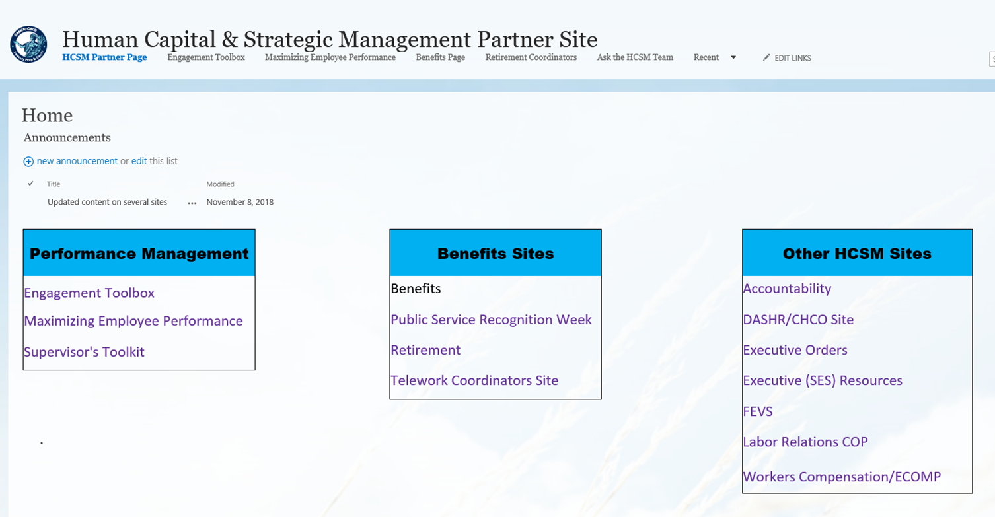
Communicating: Spreading the word (cont.)

Slide 13
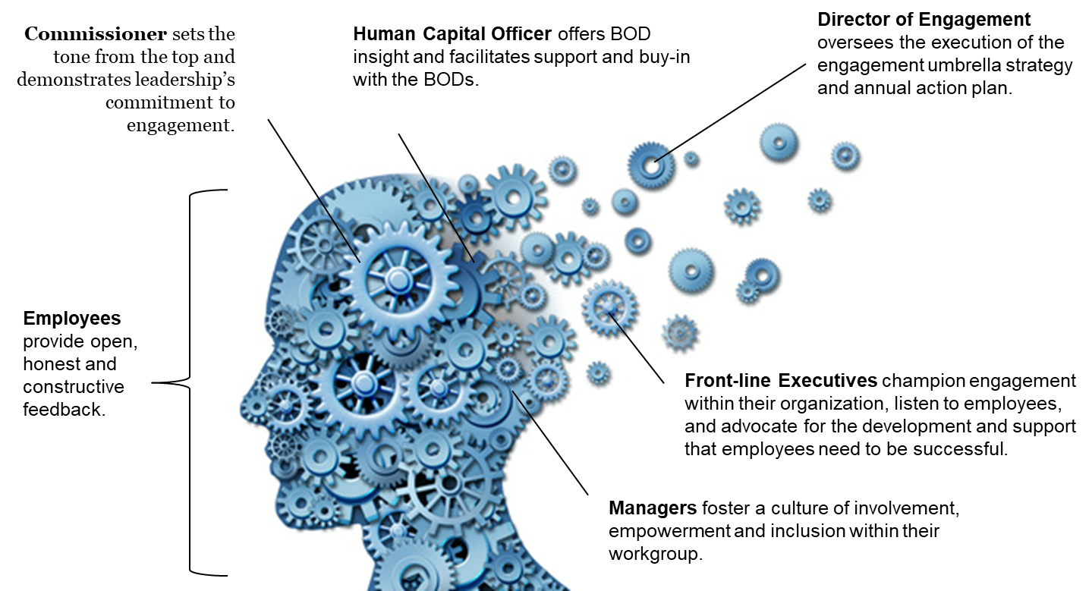
Communicating: Involve everyone

